Slide 1
PICO 640 Lynred Detector
Hafsah Amjad
Team FPGA@LEOS

Slide 2
INTRODUCTION
PICO640 Gen2™ is a high resolution (640x480 pixels) infrared image sensor for military, surveillance or thermography applications.
They use the Amorphous Silicon (α-Si) microbolometer technology to convert infrared radiation in electronic signal for use in thermal imaging cameras.
PICO640 Gen2™ sensor is capable of:
Operating at nominal 30 frames per second and up to 120 frames per second
Providing a sharp image of moving objects
Providing a raw analog video signal.

Slide 3
GENERAL DATA
Parameters
Technology | Amorphous Silicon (α-Si) microbolometer
Package type | 36 pins-PGA ceramic package
Weight | < 6.5 g
Spectral response | LWIR (wavelength from 8 to 14 µm).
Pixel resolution | 640 x 480 pixels (VGA) full format
Pixel pitch | 17 µm
Total power consumption | < 130 mW (One output) < 160 mW (Two output)
Supply voltages | Digital block: 1.5 to 3.6V Analog block: 3.6 V
Windowing | Programmable through I2C interface
Frame rate | Nominal 30 Hz (full frame) Maximum : 60Hz with 1 output, 120Hz with 2 outputs
Input clock | MC: Master Clock Maximum frequency: 40 MHz
Output clocks | PSYNC: Pixel clock HSYNC: Line synchronization signal VSYNC: Frame synchronization signal

Slide 4
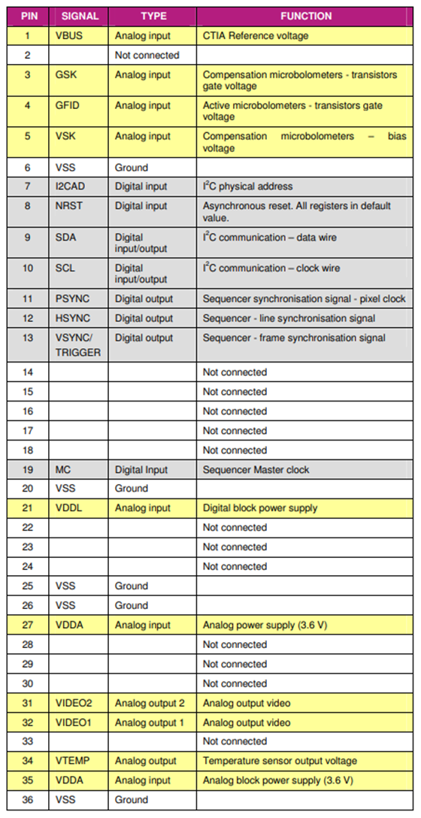
ELECTRICAL INTERFACE
PICO640 Gen2™ sensor is a 36 pin sensor.
Some pins are Digital input/output.
Some pins are Analogue input/output.
Some pins are floating i.e. not connected.
The detailed pin description is given in the table.

Slide 5
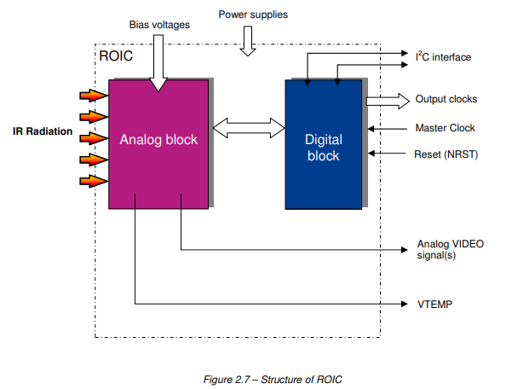
Read Out Integrated Circuit (ROIC)
The main function of the Read Out Integrated Circuit (ROIC) is to convert the infrared radiation in electronic signal depending on the thermal emissions from objects in the scene.
The Read Out Integrated Circuit (ROIC) is composed of two main blocks:
An analog block
A digital block

Slide 6
Analog Block
The main function of the analog block is to extract a weak signal from the background current produced in each active bolometer and generate a raw analog video signal for each pixel.
The block diagram of the analog block includes four main parts:
Pixel array
Skimming
Current Voltage conversion and Integration
Multiplexing

Slide 7
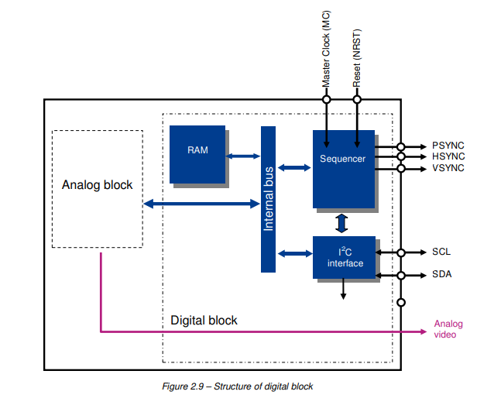
Digital Block
The digital block includes a sequencer which generates:
Three clocks used to synchronize the video signal:
VSYNC (Frame synchronization signal)
HSYNC (Line synchronization signal)
PSYNC (Pixel clock)
The sequencer requires:
A Master Clock (MC)
An asynchronous reset (NRST)

Slide 8
SEQUENCER INPUTS
Master Clock (MC)
A reference clock (MC) is required to synchronize the ROIC.
MC maximum frequency must be 40MHz.
MC frequency must be greater or equal to 14 times the SCL frequency.
Asynchronous reset (NRST)
When NRST = 1, all the registers are initialized with their default value.
When applying NRST = 1, the sequencer is not yet activated.

Slide 9
SEQUENCER OUTPUTS
The sequencer generates three output clocks to synchronize the video output signal from the detector.
PSYNC (Sequencer – Pixel clock)
The pixel clock is the clock rate of pixels in a video stream.
Its frequency must be half the frequency of Master Clock (MC).
fPSYNC= fMC/2

Slide 10
SEQUENCER OUTPUTS
HSYNC - Line synchronization signal
This signal is used to synchronize the video output along with other output clocks.
Data is valid when HSYNC=1
VSYNC - Frame synchronization signal
This signal is used to synchronize the video output along with other output clocks.
To synchronize the sensor with other systems, frame synchronization pin (VSYNC pin13) is configured as an input and a trigger signal is send to start a new frame.
A new frame will start every time a rising edge is sent on the VSYNC/Trigger pin.

Slide 11
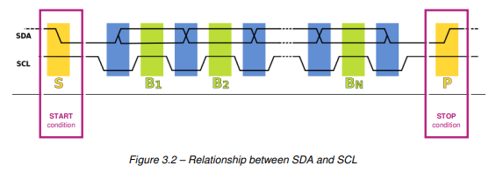
I2C SERIAL INTERFACE
The 2-wire (SDA and SCL) I2C serial interface is used to tune the PICO640 Gen2™ sensor by reading and writing the Read Out Integrated Circuit (ROIC) control registers.
The I2C bus uses two bidirectional signals, one as the serial clock (SCL) line and one as the serial data (SDA) line.
To start and stop communication a unique set of conditions are implemented between the data (SDA) and clock (SCL) lines.
The relationship between the SDA and SCL at the start and stop of communication is that An I2C protocol start occurs while the SCL is high and the SDA transitions from high to low. In order to stop communication, the SDA has a rising edge while the SCL is high.

Slide 12
INTEGRATION PARAMETERS
Default integration and gain parameters are:
• GAIN = 101 (CINT = 6 pF)
• TINT = 623 x PSYNC (TINT ≤ (Number of column/Number of output) - 13)
TINT is the Value of integration duration.
The user can modify these parameters using the I2C interface.
TINT minimum value is 1 period of PSYNC.
An internal safety circuit (watchdog) limits the integration time to around 400 µs.

Slide 13
INTERLINE and INTERFRAME
Defaults INTERLINE and INTERFRAME parameters are preset in factory as follows:
• INTERFRAME = 0
• INTERLINE = 0
• INTERLINE
By default, inter-line duration (HSYNC=0) is 23 * PSYNC
User can increase the inter-line duration by changing INTERLINE register value using I2C interface as:
Interline duration = (23 + INTERLINE) * PSYNCH

Slide 14
INTERLINE and INTERFRAME
• INTERFRAME
By default, inter-frame duration (VSYNCH=0) is 22 * PSYNCH
User can increase the inter-frame duration by changing INTERFRAME register value using I2C interface as:
Interframe duration = (22 + INTERLINE + Number of columns * INTERFRAME) * PSYNCH

Slide 15
WINDOWING
The user can reduce the sensitive array dimension using the I2C interface.
The user defined window is defined by writing in the appropriate I2C registers the coordinates of the pixels located at the four corners of the pixel array.
If the user defined window does not correspond to the sensor full format, the bit “WINDOW” (bit 1) of the “CONFIG” register must be set to 1.

Slide 16
IMAGE FLIP
The image could be flipped in horizontal and vertical direction using the I2C interface.
The scanning direction is defined by setting the bits UPCOL and UPROW in the appropriate I2C register.

Slide 17
TEMPERATURE SENSOR SENSITIVITY (VTEMP)
It allows the user to know the temperature of the Focal Plan Array and may be used to perform the FPA temperature regulation.
On the pin32-33 VIDEO1/2, the VTEMP data is available in the middle of the inter-line time.
There are two modes:
• High sensitivity is 14.8mV/°C. No equation is available to calculate the VTEMP value.
• Low sensitivity is -4.8mV/°C. One equation allows user to calculate FPA Temperature.

Slide 18
TWO OUTPUTS MODE
PICO640 Gen2™ gives the possibility to run the detector above 60 frames per seconds and up to 120 frames per seconds.
If the detector has to be run at frame rates higher than 60Hz in full format, or if the configuration requires a MC>40MHz, the user can switch to 2 outputs mode.
For the default configuration of one output, the Two_output bit must be 0.
To use the detector with two outputs, the Two_output bit must be 1.

Slide 19
NOMINAL CONFIGURATION FOR QUICK START
At ambient temperature = 300K, after having applied the starting sequence, the following nominal configuration enables the user to have video output signal in the lower part of the output dynamic.
MC = 19.1MHz (Frame rate = 30Hz)
SCL = 400KHz
VBUS=2.3V
GFID =2.85V (value available in the DACGFID register)
GSK must be adapted to tune VIDEO between 0.5V and 2.9V (value available in the DACGSK register)
CINT = 3.5pF (To be set through I²C register)
TINT= 623 period of PSYNC | Integration time = 65.2µs
INTERLINE = 0 & INTERFRAME = 0 (default values)

Slide 20


